Slide 1
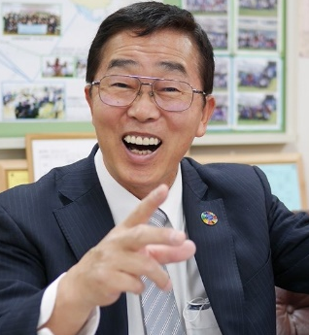
일본의 ESD의 추진 방안 日本のESDの推進方策
ESD Inter National Forum 2018
In Shizuoka Univ.
Promotion of ESD in Japanese schools
基調提案・기조 제안
「日本の学校教育におけるＥＳＤの動静」
Ｈ.Ｐ.URL:https://www.esd-tejima.com/newpage6.hltm に掲載中です。
November 23, 2018
Vice Chairman of the Japanese Society of ESD
Ｔｏｓｈｉｏ Ｔｅｊｉｍａ
Notes:
みなさんこんにちは。手島利夫です。
このフォーラムには、インドネシアやタイからの研究者の方々もおいでだそうですね。
私の学校には、これらの国々からも来客がありました。
Hello everyone. Toshio Teshima. People like Indonesian and Thai researchers are coming to this forum, are not they? My school had visitors from these countries.

Slide 2
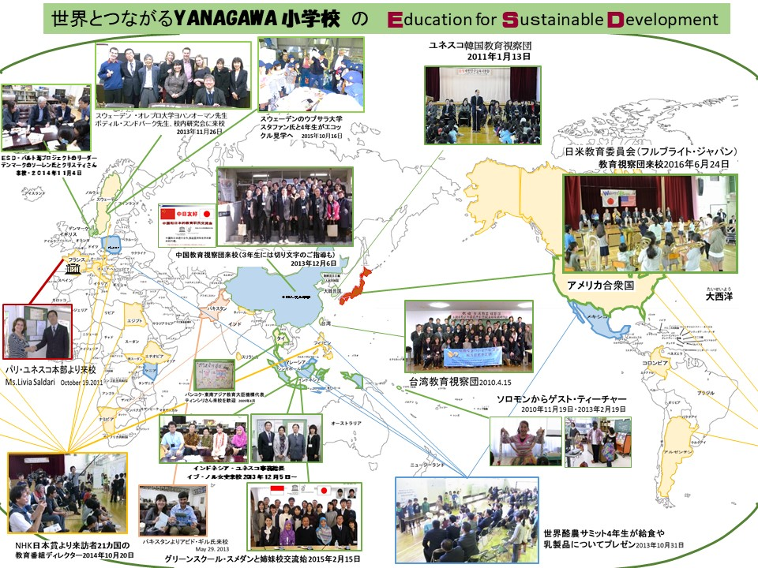
세계 교육자와 연결 YANAGAWA 초등학교
Notes:
江東区立八名川（こうとうくりつ・やながわ小学校は、東京の下町の公立小学校です。
９年前にユネスコ・アソシエーテッド・スクールズ・ネットワーク（通称ユネスコスクール）に加盟しました。
Yasakawa elementary school is a public school in downtown Tokyo.
Nine years ago I joined the UNESCO Associated Schools Network (commonly UNESCO school).

Slide 3
The Course of Study has been revised with the promotion of ESD
as the basic principle.
Responsibility as a member of society
Personal growth
Recognize your own goodness and potential,
we respect everyone else as a precious being, and we overcome various social changes while talking with various people.
as well as
And at the same time as
creating a rich life,
Growing up as a creator of a sustainable society.
This idea is ESD itself. And is the basis for the revision of this curriculum guideline.
Notes:
２０１７年３月、文部科学省は「学習指導要領」の改訂を発表しました。
In March 2017, the Ministry of Education, Culture, Sports, Science and Technology announced revision of "Course of Study".
その前文には、日本のすべての学校教育がＥＳＤの理念を重視して、「持続可能な世界の創り手」を育てることを明言しました。
In its preamble, all school education in Japan emphasized the philosophy of ESD and declared to nurture the "creator of a sustainable world".
従来の指導要領では個人の成長が重視されていました。これは大きな変化です。
Personal growth was emphasized in the traditional guidelines. This is a big change.

Slide 4
Curriculum for nurturing “Creating a Sustainable Society” For organizing, two perspectives were shown.
「持続可能な社会の創り手」を育成するための教育課程編成のために、２つの視点が示された。
① Through improving a session for realization of subject-
like and interactive and deep learning, To nurture the
power to live strongly．
主体的・対話的で深い学びの実現に向けた授業改善を通して、生きる力を育む
A problem solving-like learning process is emphasized and a
dialogue situation is placed by a cooperative situation in it.
問題解決的な学習過程を重視して、その中の協働場面で、対話場面を位置づける。
② “Curriculum management” カリキュラム・マネジメント
* Focus on cross-curriculum 教科横断的な指導
※ About the importance of the curriculum management
By the House of Councillors budget committee in October, 2014, the one in the
those days， Shimomura Minister of MEXT is speaking importantly.
Notes:
持続可能な社会の創り手を育てる方策として、２つの視点が学習指導要領に示されました。
As a way to nurture the creator of a sustainable society, two perspectives were presented in the course of study guidelines.
①は主体的・対話的で深い学びを創ること
②はカリキュラム・マネジメントををすること
① To create subjective, interactive and deep learning
② to do curriculum management
実は、カリキュラムマネジメントには、文部科学大臣が、日本の国会で、次のように答えた事実があるのです。
Actually, the curriculum management has the fact、 that the Minister of Education, Culture, Sports, Science and Technology answered in the Japanese Diet as follows.

Slide 5
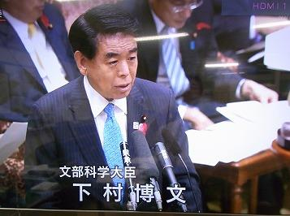
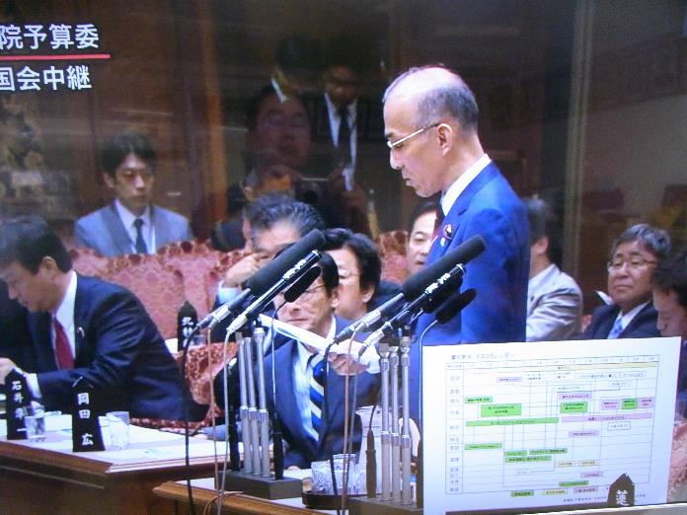
How about introducing an "ESD calendar" into Japanese school education to promote ESD?
Shimomura Minister of MEXT
I am familiar with Koto Ward YANAGAWA Elementary School.
I'd like to spread a ESD calendar among a school education in the whole country as well as UNESCO schools.
（公明党荒木参議院議員）
Oct, 8 2014 参議院予算委員会にて
（ＮＨＫ national diet news）
Notes:
下村文部科学大臣は、2014年10月に
やながわ
江東区立八名川小学校のことは、よく承知しています。
この学校で開発された、「ＥＳＤカレンダー」はユネスコスクールだけでなく、日本中の学校教育で活用させたいと考えています。」と明言しました。
I understand about a match of Koto ward yanagawa elementary school.
I'd like to spread a ESD calendar among a school education in the whole country as well as UNESCO schoolｓ.
これが、学習指導要領のカリキュラ・ムマネジメントになってきております。
This has become a curriculum management of the course of study guidelines.

Slide 6
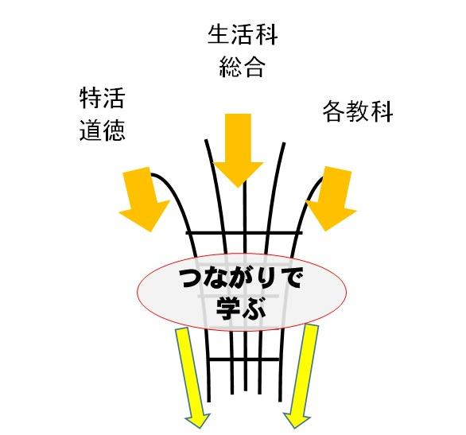
Curriculum management
LivingEnvironmentStudies 生活科
Comprehensive learning 総合
Special Activities
Japanese
Society
Mathematics
Science
Music
Fine arts
Technology and
household
Health education
and physical
education
moral
English
Conventionally, it is important to link the content that has been taught by subjects and areas with a viewpoint.
Deep Learning
of cleate
Notes:
カリキュラム・マネジメントするのは、従来、それぞれが独立して教えていたものを、視点をもって関連付けて指導することで、教育効果を高めようという狙いがあります。
Curriculum management is aimed at enhancing the educational effect by teaching and telling the things that each teach independently independently from the viewpoint.

Slide 7
現実社会で起きている問題を
解決するには、既存の科目の
勉強だけでは不可能です。
현실 사회에서 일어나고있는 문제를 해결하려면 기존 과목의 공부만으로는 불가능합니다.

Slide 8

이 페이지는 슬라이드 쇼로 볼하세요
5th grade ＥＳＤ calendar |  |  |  |  |  |  |  |  |  | Yanagawa elementary school in Koto-ku
subject | Apr. | May | June | July | Aug. | Sep. | Oct. | Nov. | Dec. | Jan. | Feb. | Mar.
Japanese
Arithmetic
Science
Social studies
General studies
Special Topics
English
Social Morality
Music
Art
PE
Home economics
Our town 100 years
From now
The next step(project report)
Investigating on the Internet
Forecasting the weather
The sizes of units
Percentages & graphs
Generation and growth of plants
Work performed by flowing water
Rice of the fertile
Shonai Plain
Our future eating
habits
Using
Information
Preventing natural
disaster
Protecting the
environment
Protecting the Earth by ourselves
Earthquake! What to do
Learning school history
Yanagawa Festival
「Hello!」「I'm happy.」
Global warming &
The disaster forests
Cleaning party on Chomolungma
Waste not want not
Poster
Injury prevention
Delicious daily food
Environmental education
Multicultural understanding
Human rights &the value of life
Study skills
Notes:
つなぎ合わせるというのは、こういうことです。ただつなぐのではなく、環境・人権・多文化の理解といった視点で学びをつなぐことが重要です。
From the viewpoint of understanding of environment, human rights, multiculturalism、 It is important to connect learning.
そうして、年間を通じて、このような学びのイメージマップを作ることが、カリキュラム・マネジメントで重要なことです。
And it is important in curriculum management to make an image map of such learning throughout the year.
しかし、いくら学びがつながっても、それを知識として教え込まれたら、子どもにとっては、迷惑でつまらない学習の時間になるだけです。
However, no matter how much it is connected to learning, if it is taught as knowledge, it will be time for children to learn annoying and boring.
そうです。教え方、学ばせ方まで計画できて、ＥＳＤの指導計画になります。
We can plan how to teach and how to learn, it will be an ESD guidance plan.
その話の前に、日本の先生向けのＰＰＡＰをご覧いただきましょう。

Slide 9
ESD 지도의 연간 계획
The YANAGAWA 교육 계획 ２０１２
제４학년
교과·영역
４월 ５월 ６월 ７월 ８월 ９월 １０월 １１월 １２월 １월 ２월 ３월
국어
산수
사회
이과
종합적인 학습
특별활동
도덕
음악
서화·공작
체육
확대와 망원을 구사해 잘 전하자.
재료를 음미해, 조사한 것
을 능숙하게 전하자.
전하고 싶은 것을 확실히 하고 쓰자．
우리의 생활과 쓰레기 처리의 방법
우리의 생활과 물
봄의 생물을
조사하자
여름의 생물을
조사하자
가을의 생물을
조사하자
겨울의 생물을
조사하자
우리의 물, 세계의 물
Kids ISO １４０００
자원의 절약
세계 유산을 배우자.
지역 청소의 날
지역 청소의 날
전교 학습 교류 축제
유니세프 모
금에의 협력
공원을 예쁘게
하자.
캄보디아에서 온 유학생
「외국인」이라고 부르지 말아 주세요.
아이의 권리 조약
(인권)
향토의 음악
모두의 작품 전람회
（자국 문화의 이해）
외국의 아동 작품
（외국 문화의 이해）
몸의 성장과 나
（생명의 존중）
환경의 관점
국제 이해의 관점
인권·생명의 관점
국제적 제휴 시스템의 이해

Slide 10
ESD 지도의 연간 계획
The YANAGAWA 교육 계획
제４학년
교과·영역
４월 ５월 ６월 ７월 ８월 ９월 １０월 １１월 １２월 １월 ２월 ３월
국어
산수
사회
이과
종합적인 학습
특별활동
도덕
음악
서화·공작
체육
확대와 망원을 구사해 잘 전하자.
재료를 음미해, 조사한 것
을 능숙하게 전하자.
전하고 싶은 것을 확실히 하고 쓰자．
우리의 생활과 쓰레기 처리의 방법
우리의 생활과 물
봄의 생물을
조사하자
여름의 생물을
조사하자
가을의 생물을
조사하자
겨울의 생물을
조사하자
우리의 물, 세계의 물
Kids ISO １４０００
자원의 절약
세계 유산을 배우자.
지역 청소의 날
지역 청소의 날
전교 학습 교류 축제
유니세프 모
금에의 협력
공원을 예쁘게
하자.
캄보디아에서 온 유학생
「외국인」이라고 부르지 말아 주세요.
아이의 권리 조약
(인권)
향토의 음악
모두의 작품 전람회
（자국 문화의 이해）
외국의 아동 작품
（외국 문화의 이해）
몸의 성장과 나
（생명의 존중）
환경의 관점
국제 이해의 관점
인권·생명의 관점
국제적 제휴 시스템의 이해

Slide 11
Environmental
education
International
cooperation
Environmental education alone,
cannot solve real
environmental problems.
For international cooperation, it is important to understand and respect each other's cultures and customs. Otherwise we cannot cooperate.
Four viewpoints for
sustainable global development
To know each other's culture and customs, it is important to respect each other as a person.
And a good environment is indispensable for people to live. The four perspectives are connected to each other.
Education in humanrights
and respect for life
Multicultural
understanding
Notes:
総合的な学習の時間で学習する内容は、これからの厳しい時代を生きていく子どもたちに考えてもらいたい４つのテーマから設定されています。
Content to be learned in comprehensive learning time is set from four themes that children wanting to live in the tough period of the future think.
持続可能な世界を実現するのには、例えば環境の問題だけ取り出して、解決できるほど現実は簡単ではありません。
To realize a sustainable world, reality is not easy enough to solve, environmental problems alone and solve it.
環境問題では、自分たちだけが取り組むのではなく、国際的な協力が必要です。国際的な協力をするためには、お互いの国の文化や生き方を尊重できなくてはなりません。
In environmental problems, not only themselves are working, but international cooperation is necessary. In order to cooperate internationally, we must be able to respect each other's culture and way.
世界の人々と理解し合うには、同じ地球市民として、一人一人を大切にする人権意識が重要です。
このように４つのテーマを各学年で学習することは、ﾕﾈｽｺｽｸｰﾙとしてＥＳＤを推進することにもつながります。
Human rights awareness that values ​​each person as the same global citizen is important for understanding with the people of the world. Learning the four themes in each grade like this, will lead to promoting ESD as a UNESCO school.

Slide 12
An Example Teaching Plan
Ｙａｎａｇａｗａ elementary school
国際連合 教育科学文化機関 UNESCO には
Education for Sustainable Development
とういう教育課題があります。
Protecting the Earth by ourselves (４０ｈours)
Name of unit Hours
【Aims】
Study process for solving problems
1 【Stimulate thirst for learning】
2 【Investigation】
3 【Compilation】
4 【Communication】
Global manpower and related organizations
Notes:
これは、その単元の学びをどのように指導するかを示した、簡単な指導計画です。
This is a simple guidance plan showing how to instruct learning of that unit.
どのようなタイトルについて、何時間かけて、どのような目標で、そして、どのような指導過程で学ばせるかを示しています。
It shows what kinds of titles, hours, what goals, and what kind of teaching process to learn.
この計画を先ほどのイメージマップとセットにすることで、指導計画として、大きな力を発揮します。
By setting this plan together with the previous image map, we will demonstrate great power as a guidance plan.

Slide 13

School ESD Calendar
国際連合 教育科学文化機関 UNESCO には
Education for Sustainable Development
とういう教育課題があります。
To clarify teaching content and activities
So that anyone can teach it
With an ESD calendar, teachers can teach in any grade.
Notes:
この指導計画ができたことで、教師たちは喜びました。
⑴ 何をどのように学ばせるか明確になった。
⑵ だれでも、見通しをもって指導ができるようになった
⑶ だから、だれが何年生を受け持っても、指導ができるようになった。
Teachers were pleased that this guidance plan was made.
⑴ It became clear what to learn and how.
⑵ Anyone can provide guidance with prospects
⑶ Therefore, no matter who is responsible for what grade it is possible to teach.

Slide 14
参考：ハーバード大学・エリック・マズール教授による
ラーニングピラミッド
授業で学んだ内容の半年後の記憶
National Training Laboratories 3
Ｄｉｓｃｕｓｓｉｏ
Ｌｅｃｔｕｒｅ
ただ座って，先生の話を
聞いているときの脳の
活動は、眠っているとき
と同じレベルだそうです。
数値（％）は削除しています。
指導者によってもこの
順番が一定とは
言えません。とは言え
このような視点は
大事です。
Reading
Ａｕｄｉｏｖｉｓｕａｌ
授業改善対策として、これを使わない手は、ありません。
八名川まつりは、この部分を活用した学習発表の場です。
Ｄｅｍｏｎｓｔｒａｔｉｏｎ
Discussion Group
Practice Doing
Teaching Others
It is important to incorporate efficient learning "activities" 、as well as one-sided education.
Notes:
八名川（やながわ小学校では、教え込む方法だけでなく、様々な体験的な学習活動も、大いに取り入れています。
As a result of this guidance plan, not only the teaching method but also a variety of experiential learning activities are taken into consideration by teacher Yanagawa elementary school.
子どもたちには、大勢の色々な人に向けて、相手に合わせた発表の体験もさせています。
For children, we also have a variety of people to experience the presentation tailored to the opponent.
その結果、児童が、とても積極的に学ぶようになってきています。
As a result, students are learning very actively.

Slide 15
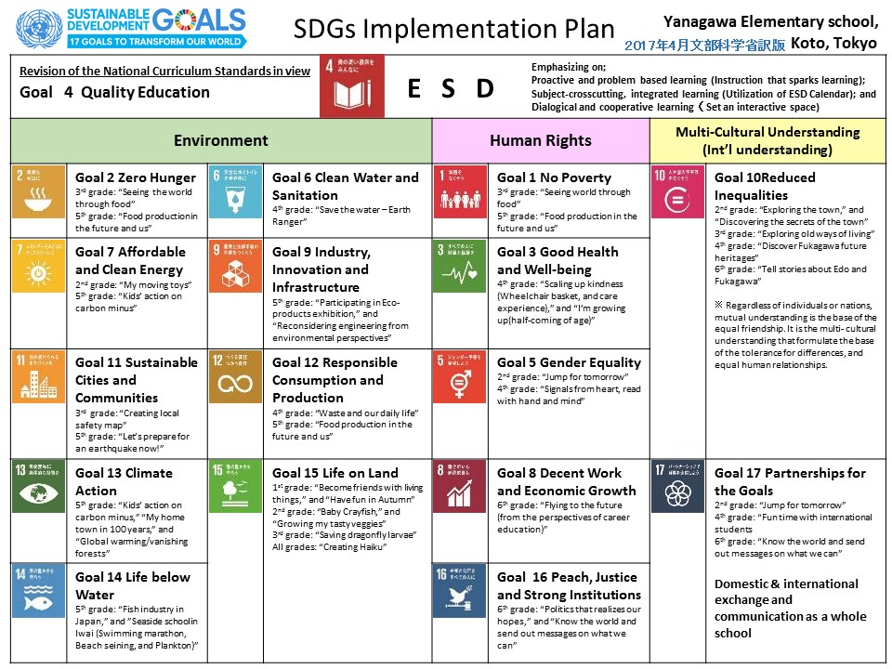
Notes:
また、ＳＤＧｓでは。１７のゴールが示されています。
In SDGs. The goal of 17 is indicated.
ＳＤＧｓへの取り組みも、学校に求められるでしょう。
Efforts on SDGs will also be required for schools.
そこで、八名川小学校では、今までに取り組んできたＥＳＤで開発し、実践してきた単元名や学年をＳＤＧｓの項目に当てはめてみました。
Therefore, at Yanagawa Elementary School, I applied the unit name and grade student developed and practiced by ESD which I have been working on, so far to the items of SDGs.
すると、１年生から６年生までの間に、１６全ての項目に実践があることがわかりました。
１７個めはＥＳＤです。ＥＳＤは全てを包括しているのです。
Then, between 1st grade and 6th grade, I realized that there are practices in all 16 items. The 17th is ESD. ESD is inclusive of everything.

Slide 16
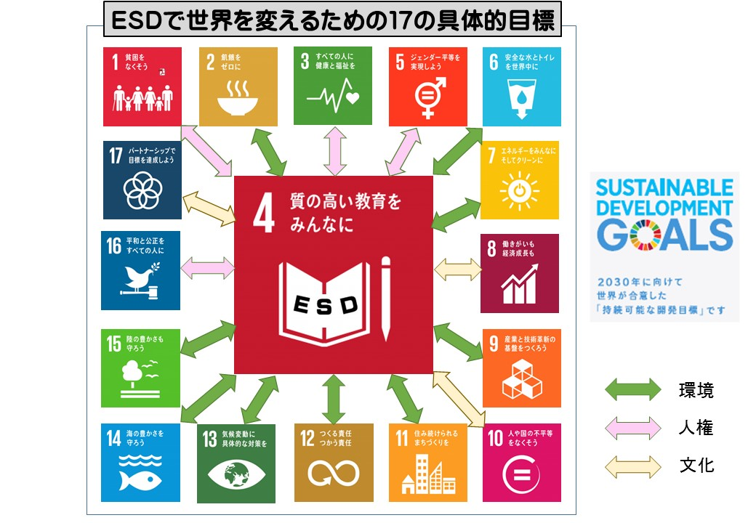
Notes:
そのことを図に表すと、このようになります。
ＳＤＧｓの推進には、教育の力がどうしても必要になります。
This is represented in the figure as follows. To promote SDGs, educational power is absolutely necessary.
ＳＤＧｓを部分的に取り組んだり、ある期間だけ競争的に取り組んで、その結果によって表彰されたとしても、
世界のことを自分の問題として理解できていないとしたら、彼らはそれを継続できません。
Even if you partially engage SDGs, work on competition only for a certain period, and be honored by the results, If they can not understand the world as their own problem, they can not continue.

Slide 17
Notes:
ＳＤＧｓ実践計画表とＥＳＤカレンダーを関連付け、さらにそれを学習者が主体的になるような学び方で指導をすることこそが重要なのです。
It is important to associate the SDGs Practice Planning Table with the ESD Calendar and to teach it with a way of learning that makes the learner subjective.

Slide 18
Notes:
この写真のように、学習発表会を開き、学習者が互いに学び合っていくことも大事です。
Like this photo, it is important to have a learning presentation and learners to learn from each other.
さらに、この発表会は地域にも保護者にも、日本中の研究者や関係機関の方々にも、開かれています。
In addition, this recital is open to researchers and related organizations in Japan both in the community and in the parents.
色々な方がここから学び、自分の学校での実践に生かしてくれるようになりました。
Various people learned from here and began to make use to practice at my school.
大学の研究者や行政の方々も、ＥＳＤの具体的な姿を目にして、指導な在り方の参考にしてくださいました。
The university researchers and administrative people also saw the concrete appearance of ESD and made reference to the guiding style.

Slide 19

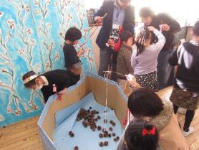
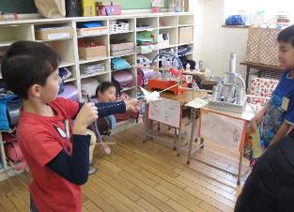

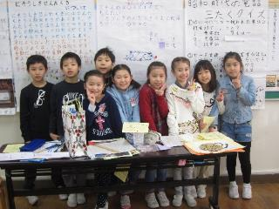

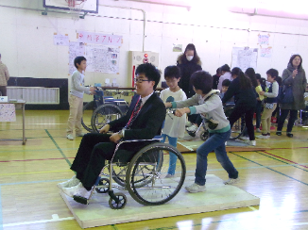

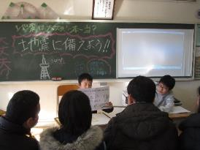

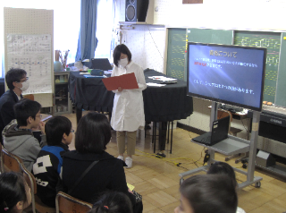

YANAGAWA ESD Festival
Once a year, children of all grades share their ESD learning outcomes. This opportunity is very important for their growth.
第7回八名川まつり発表内容
１年 秋のおもちゃの店
２年 うごくおもちゃ大しゅう合
３年 八名川タイムトラベル
４年 やさしさパワーアップ大作戦
５年 今やろう！ 地震から身を守る備えを！
６年 未来にはばたけ！ ～小学校卒業研究～
ドングリやまつぼっくりで楽しもう
ゴムで、風で、坂道で・・・いっしょにあそぼ！
町の史跡や道具を調べて語ります。
妊婦さん・外国人・お年寄り・・・・
保護者や地域の方と備えを語る
キャリアの視点から将来設計と学び方を語る
Notes:
これは、昨年のYANAGAWA、ＥＳＤまつりの案内です。今年度は、２月１６日に開かれます。
This is a guide of last year‘s YANAGAWA, ESD Festival. This fiscal year, it will be held on February 16
学校中の全ての子どもが発表者にも聞く人にもなります。そして、お互いの取り組みの成果を発表し合います。
Every child in the school can also be a speaker of presenters. And we will announce the achievements of each other's efforts.
ゲームで伝えるもの、劇で伝えるもの、紙芝居を見せるもの、クイズを入れながら説明するもの、実物を見せながら話すもの、
プレゼンテーションソフト（パワーポイント）を使うもの、それぞれの子どもが、様々に工夫して説明します。
Things to tell in the game, things to tell in the play, those to show the picture-story show, Things to explain with quizzes, Things to talk while showing the real thing, Those using presentation software (PowerPoint), each child will devise various explanations and explain.
保護者や幼稚園児、地域の大人、日本中の学校等からの来校者など、様々なな人に伝えるので、コミュニケーション能力も高まります。子どもたちは学年を越えて、学びでつながり合います。
Communicating skills are also enhanced because it tells various people such as parents, kindergarten children, local adults, campers from schools in Japan, and so on. Children cross the grade and connect with each other by learning.

Slide 20
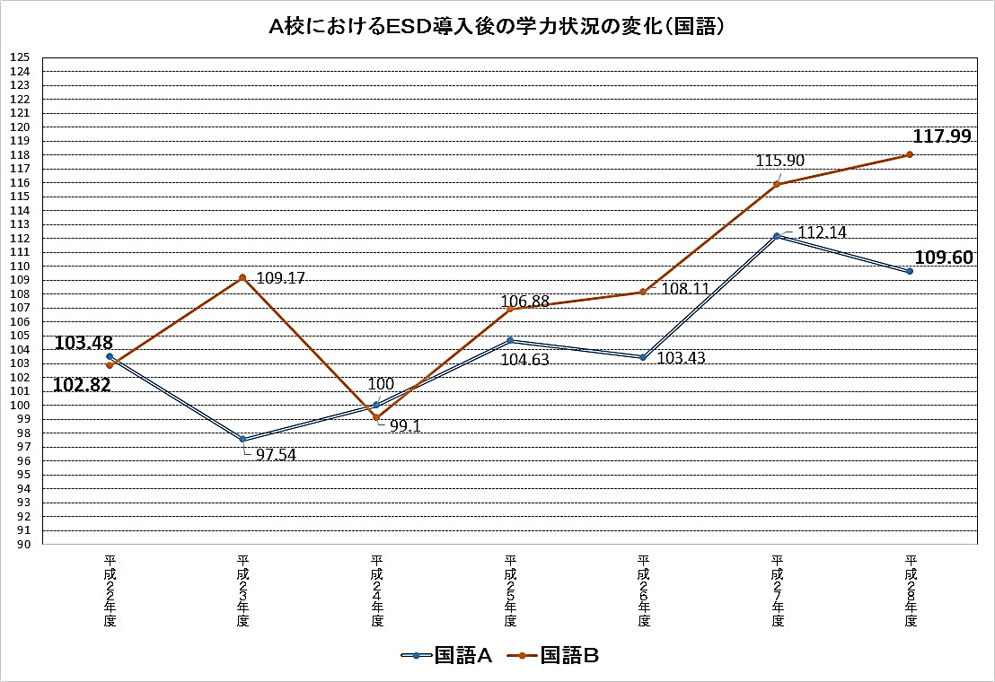
The scholastic aptitude of Japanese improved.
A change at the Yanagawa elementary school.
２０１０ ２０１１ ２０１２ ２０１３ ２０１４ ２０１５ ２０１６
Notes:
当然のことながら、学力も上がります。
これは国語の学力（特に活用能力）が１５％も伸びている様子です。
As a matter of course, academic ability also rises. This is how the academic ability of the national language (in particular the utilization ability) is increasing by 15%.

Slide 21
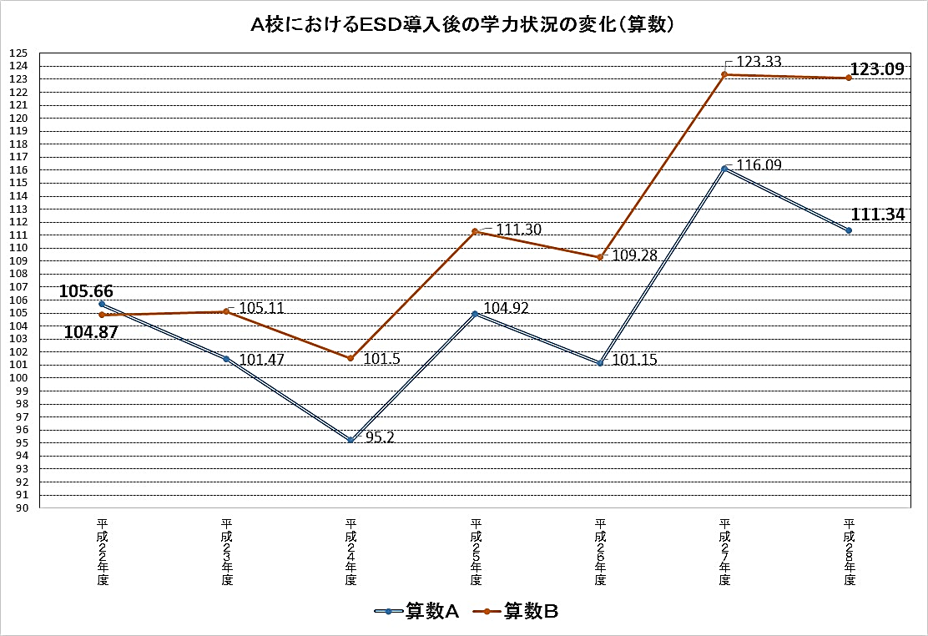
Children's math skills have also improved. But most importantly, they have grown into nice people.
２０１０ ２０１１ ２０１２ ２０１３ ２０１４ ２０１５ ２０１６
When ESD is promoted, child's mind to do rises, and the utilization ability also grows.
Notes:
算数の学力も伸びました。
私たちの学校では、「学力を伸ばせ」とは言っていません。
「学力は、ＥＳＤを取り組んでいれば、後から自然に育つのだ」
と言ってきました。
事実は、その通りになっています。
The academic ability of mathematics also grew.
In our school, we do not say "to improve our academic ability". "Academic ability grows naturally afterwards if you are working on ESD." I said that.
The fact is right.

Slide 22
Notes:
ＥＳＤの推進は、私たち共通の課題です。
互いに学び合って、この重要な課題の解決に向かって、協力を続けていきましょう。
以上で説明を終わります。Toshio Tejima でした。
Promotion of ESD is a common issue for us.
Let's learn from one another and let's continue to cooperate toward solving this important issue.
It ends the description above.
It was Toshio Tejima.

